Slide 2
MODULE 4: AGRIBUSINESS OPPORTUNITIES & VALUE ADDITION

Slide 3
Agribusiness Opportunities (Concept)
A profitable idea within the agricultural value chain
It Includes production, processing, marketing, services
It Requires market demand, scalability, compliance.

Slide 4
Criteria for Evaluating Opportunities
Market demand
Cost of inputs
Profit margin
Scalability
Environmental & social impact
Policy compliance

Slide 5
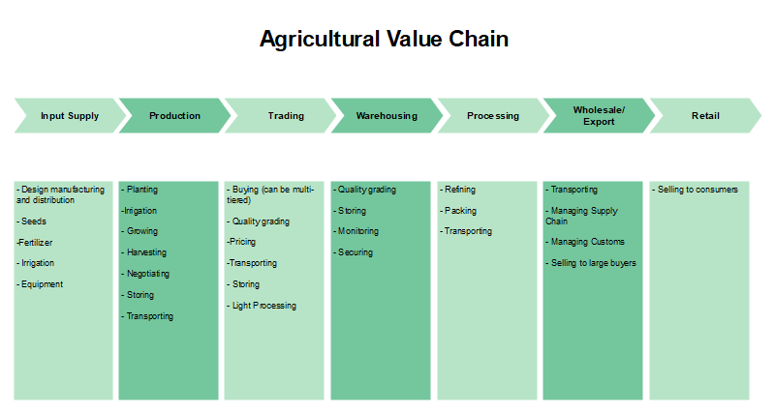
Agricultural Value Chain (Flow)

Slide 6
Value Chain Input Supply Stage
Seeds
Fertilizers
Machinery
Agrochemicals
Animal feed

Slide 7
Production Stage
Crop cultivation
Livestock production
Focus on yield & sustainability
Processing & Storage Stage
Sorting
Grading
Drying
Cold storage
Packaging

Slide 8
Transportation & Marketing
Distribution logistics
Wholesale & retail
Branding & pricing
Export opportunities

Slide 9
Common Problems in Agriculture
Limited market access
Post-harvest losses
Low productivity
Input supply challenges
Poor extension services

Slide 10
Market Trends in Agriculture
Organic foods demand
Traceability systems
Convenience foods
Plant-based proteins
Eco-friendly packaging

Slide 11
Emerging Technologies
Precision agriculture (GPS, drones)
Vertical farming
Smart irrigation
Data-driven farming

Slide 12
Value Addition Concept
Transform raw products into higher-value goods
Example: maize → flour
milk → yogurt
cassava → garri
Importance of Value Addition
Creates jobs
Reduces wastage
Allows off-season sales
Improves income stability
Access to premium markets

Slide 13
Types of Value Addition
Form value
Place value
Time value
Convenience value
Packaging & branding
Nutritional value

Slide 14
Forms of Value Addition
Primary: sorting, grading
Secondary: drying, milling
Tertiary: branding, retail packaging
Value Addition Process Flow
Production → Processing → Packaging → Branding → Distribution

Slide 15
Agribusiness Innovation
Application of new technologies
Improves efficiency & competitiveness
Driven by policy, markets & consumer demand
Types of Innovation
Product innovation
Process innovation
Marketing innovation
Organizational innovation

Slide 16
Challenges in Value Addition
Limited processing technology
Poor infrastructure
Limited capital
Skills gap
Regulatory hurdles
Production & Operations Management
Planning, organizing & controlling agricultural production
Ensures efficiency & sustainability

Slide 17
Components of Operations Management
Production planning
Scheduling
Supply chain logistics
Technology use
Cost control
Compliance standards

Slide 18
Technology in Agribusiness Operations
Drones & sensors
Farm management software
Smart irrigation
Automated machinery
Precision Agriculture

Slide 19
Advantages of Operations Management
Increased productivity
Better quality output
Efficient resource use
Improved market response

Slide 20
Limitations / Challenges
Weather variability
Labor shortage
Input price fluctuation
Infrastructure gaps

Slide 21
Summary
Agribusiness opportunities exist across value chains
Value addition increases income
Innovation improves competitiveness
Operations management ensures efficiency

